Slide 1
Taylor Series
泰勒級數

Slide 2

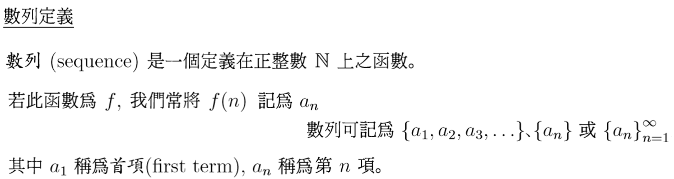

Slide 3



Slide 4





Slide 5
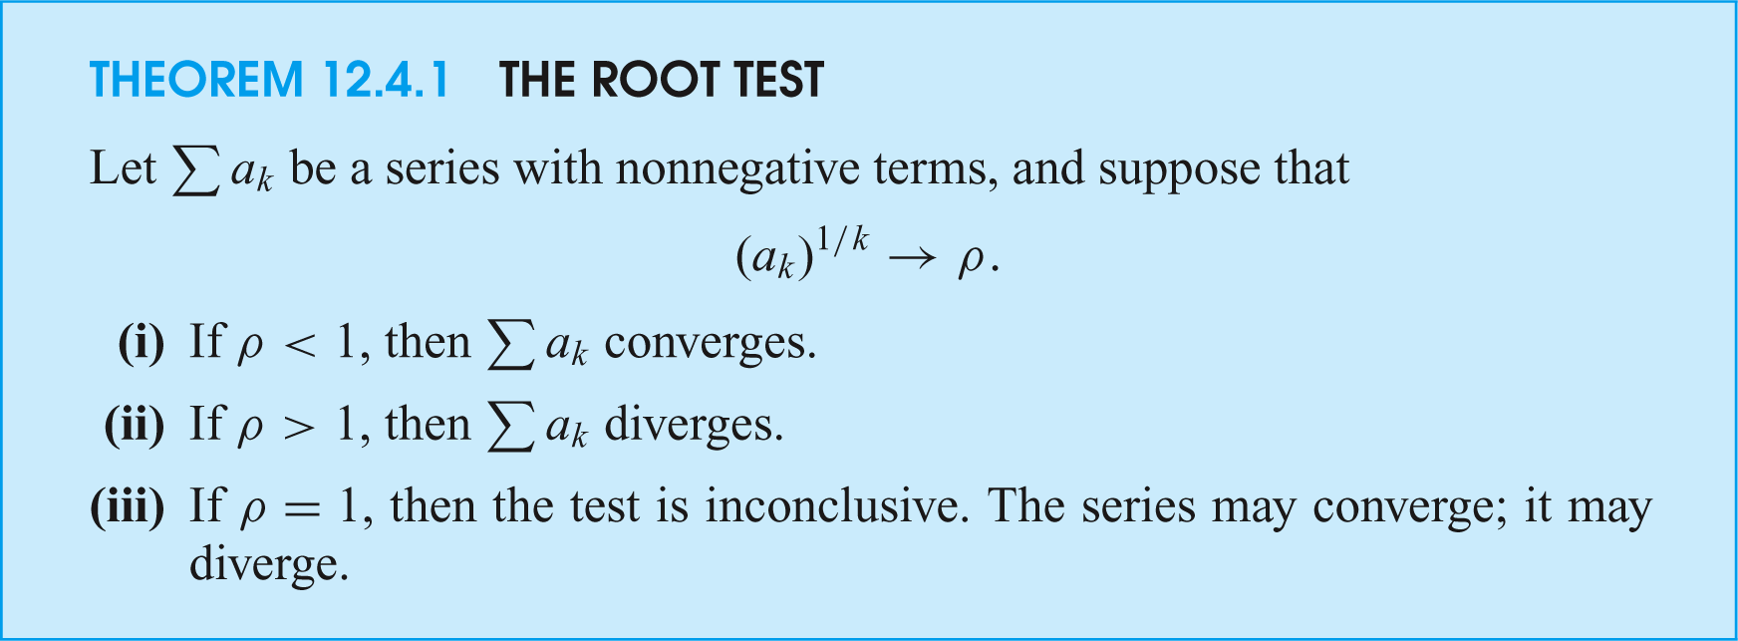
The Root Test; The Ratio Test
lim
k→∞
沒有定論

Slide 6
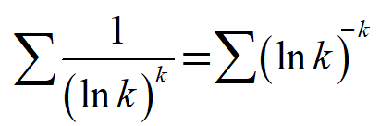
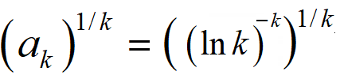

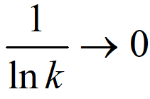
Example 1
Proof the series is converges.
Applying the Root Test
lim
k→∞
∞
The series converges.
#

Slide 7
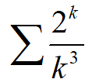
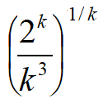
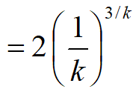

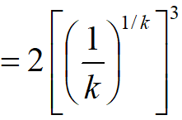


Example 2
Proof the series is diverges.
Applying the Root Test
0⁰=1?
0
0
lim
k→∞
The series diverges.
#

Slide 8
羅必達原理
分子/分母兩邊微分
*
#

Slide 9
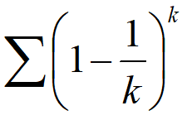
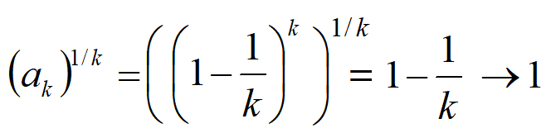
Example 3
Proof the series is diverges.
Applying the Root Test
0
Here the root test is inconclusive.
沒有定論

Slide 10
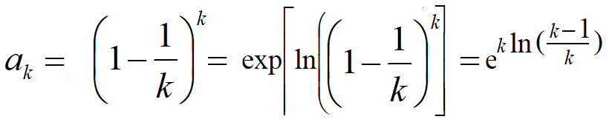
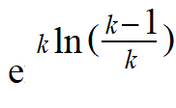
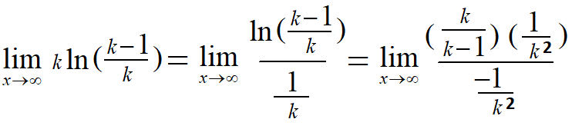

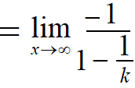

a_{k}
羅必達原理
分子/分母兩邊微分
k
k
k
Since a_{k} = (1-1/k)^{k}
k
lim ak tends to
e⁻¹
0
k→∞
and not to 0, the series diverges.
k
#

Slide 11
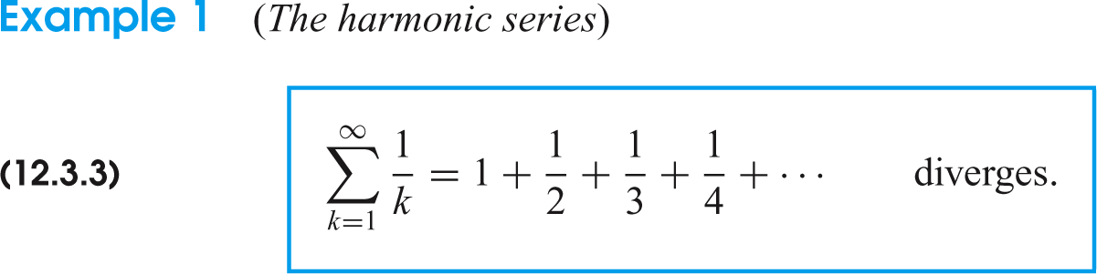

The Integral Test; Basic Comparison, Limit Comparison
Proof:
瑕積分
∞
0
diverges

Slide 12
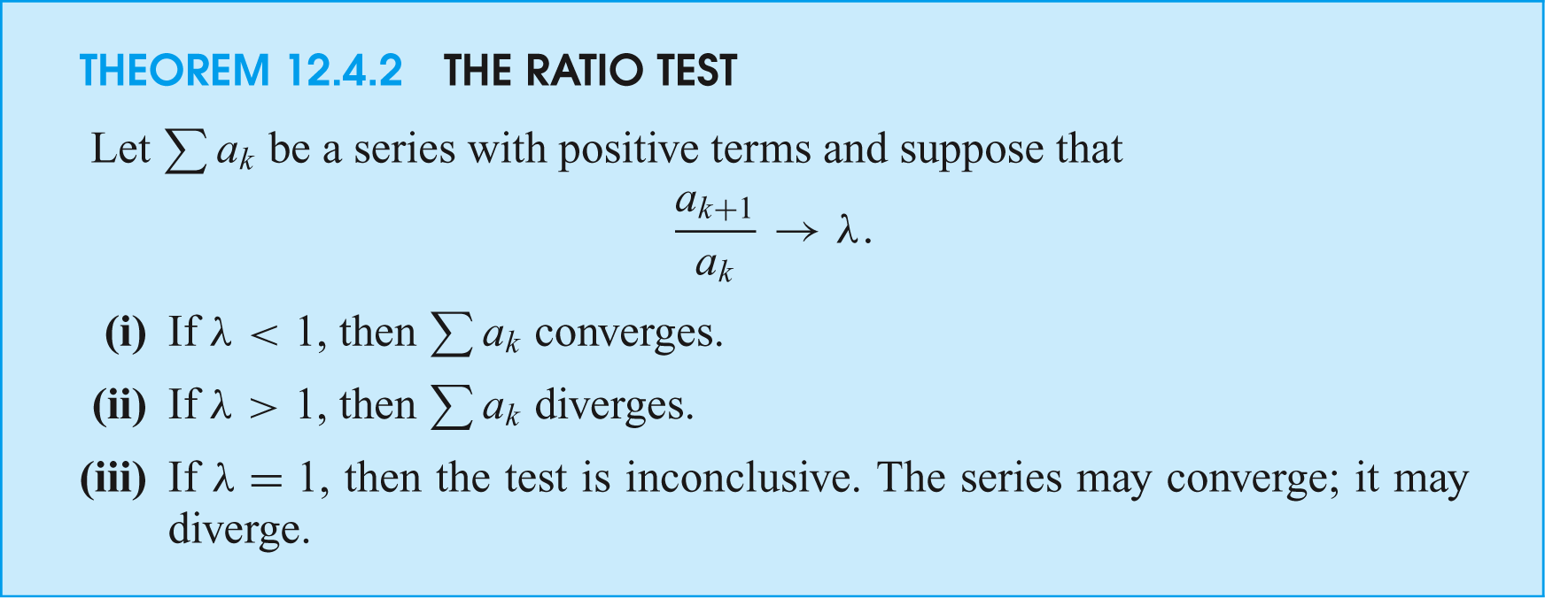
The Root Test; The Ratio Test
lim
k→∞
沒有定論

Slide 13
#

Slide 14
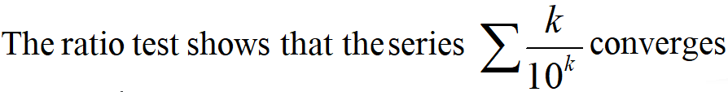
The series converges.
#

Slide 15
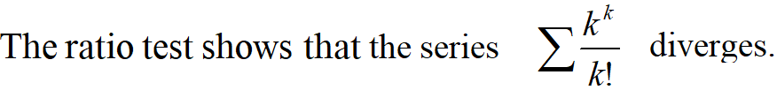
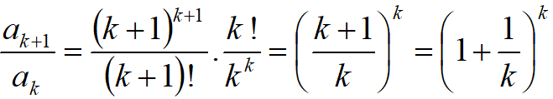
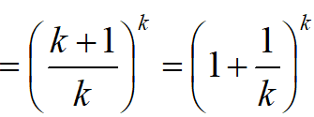
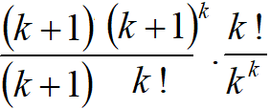




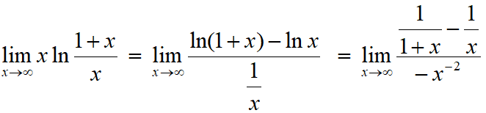


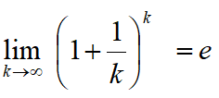
羅必達原理
0
分子/分母兩邊微分
#

Slide 16
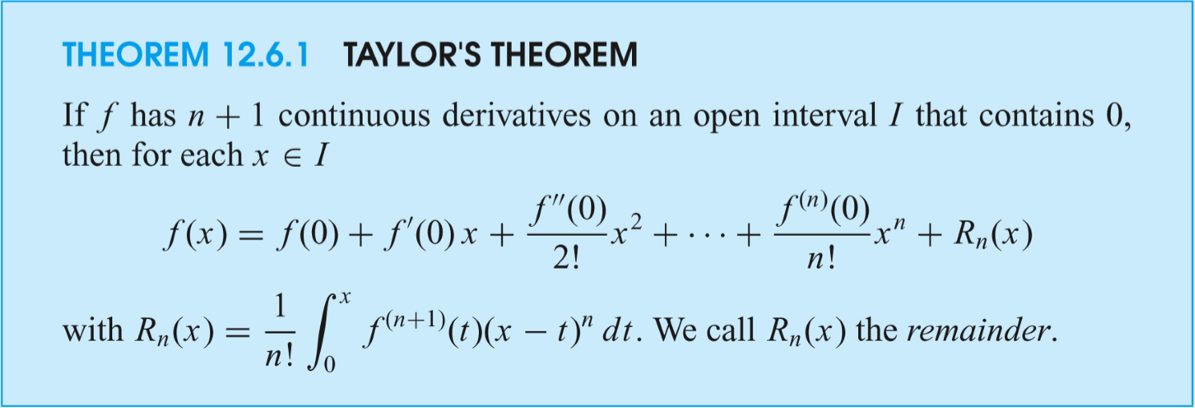
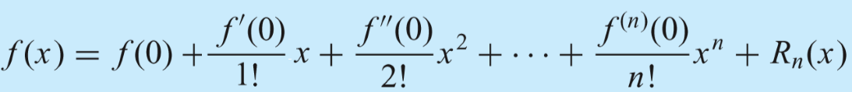

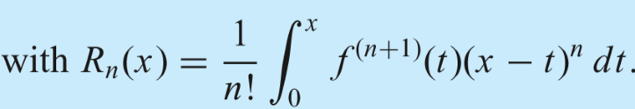

, Taylor Polynomials

Slide 17









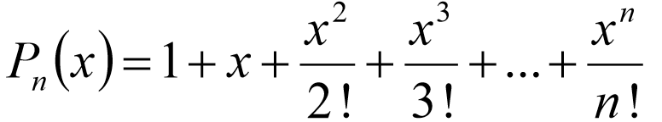
Taylor Polynomials in x; Taylor Series in x
Example 1 The exponential function f (x) = e^{x}
has derivatives
Thus
The nth Taylor polynomial takes the form

Slide 18
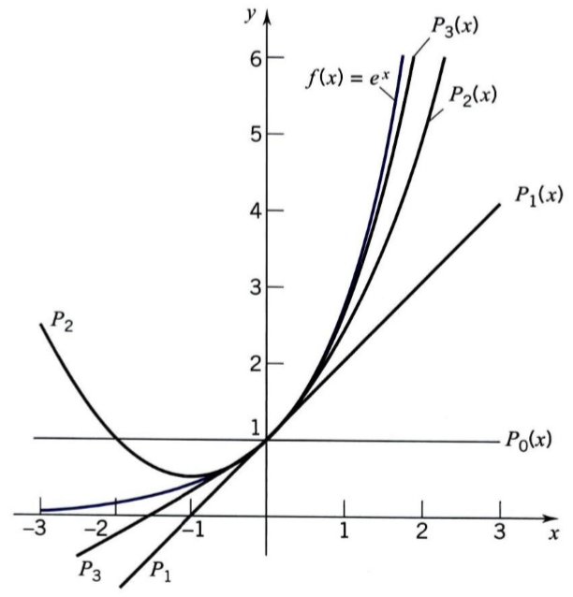
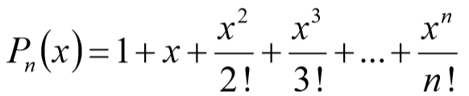
P_{n}(x)=
= 1+x+x²/2! +x³/3!
= 1+x+x²/2!
= 1+x
f (x)= e^{x}
= 1
P₀
P₁
P₂
P₃
P_{n}
Figure shows the graph of the exponential function and the graphs of the first four approximating polynomials.

Slide 19












Example 2 To find the Taylor polynomials that approximate the sine function, we write
偶微分項
奇微分項
At x = 0, the sine function and all its even derivatives are 0.
The odd derivatives are alternately 1 and -1:
偶微分項
奇微分項

Slide 20








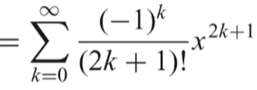

P₀
P₁
P₂
P_{n}
奇
偶
Therefore the Taylor polynomials are as follows:
Only odd powers appear.
This is not surprising since the sine function is an odd function.
#

Slide 21

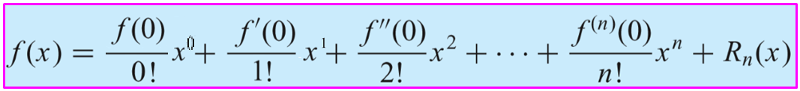
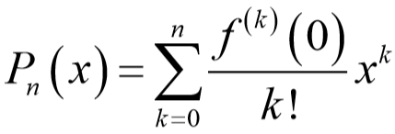
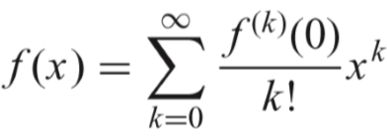
By definition 0! = 1.
Taylor Series in x,

Slide 22
